Slide 1
Acute pancreatitis in pediatrics
Presenter: R3 吳聖婷
Supervisor: Attending 王建得

Slide 2
Patient’s profile
Name: 莊OC
Age: 13Y9M
Sex: Male
Chart No.:CCCCC
Admission date: 106/12/11

Slide 3

Chief Complanit
X 4 hours

Slide 4
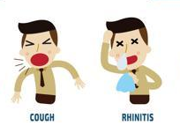

Clinical Coarse
X 10 days
-> LMD: symptomatic control medication
12/1 12/11 0am 12/11 3am
  (竹山秀傳 ER) our PER
  Lab:
  ↑amylase(402) , ↑ lipase(622)
  Tx:
  Ranitidine and buscopan
  Lab:
  leukocytosis( WBC: 15060),
  ↑ amylase(438) and ↑ lipase(588)
  Abdominal sonograpgy:
  1.Mild hepatomegaly,
  2.Intestine ileus, 3.Ascites.

Slide 5
Others
Birth history: G3P2A1, C/S, BBW: ~ 3000gm
Family history:
  Parents: both thalassemia minor
  older sister died shortly after birth due to severe thalassemia.

Slide 6
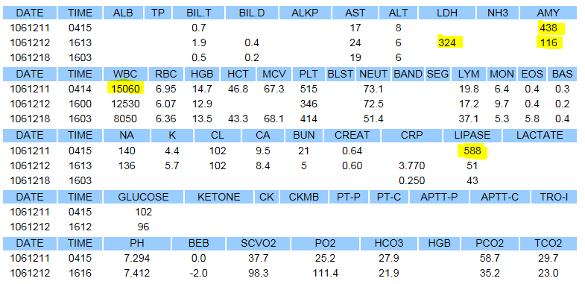
Lab

Slide 7
Impression
1. Acute pancreatitis
2. Thalassemia

Slide 8
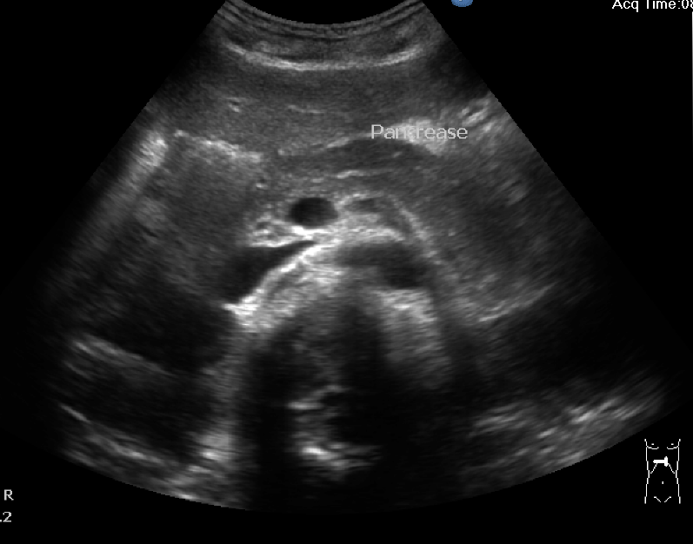
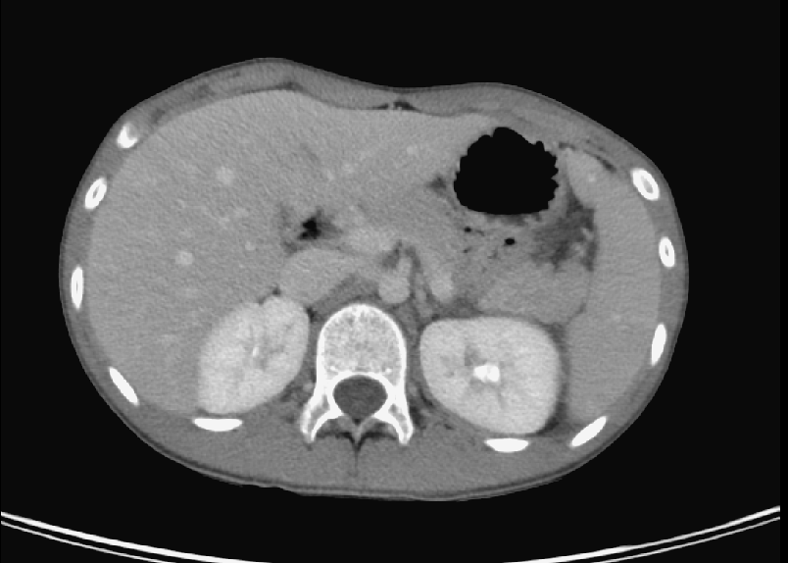
Image
Notes:
Indistinct margin of pancrease with hypoattenuation in the
pancrease tail. Fluid accmumlation in left paracolic gutter
and douglas pouch.

Slide 9
Treatment
Pain control with Pethidine
NPO until no vomiting
Fluid supplement

Slide 10
Acute pancreatitis in pediatrics

Slide 11
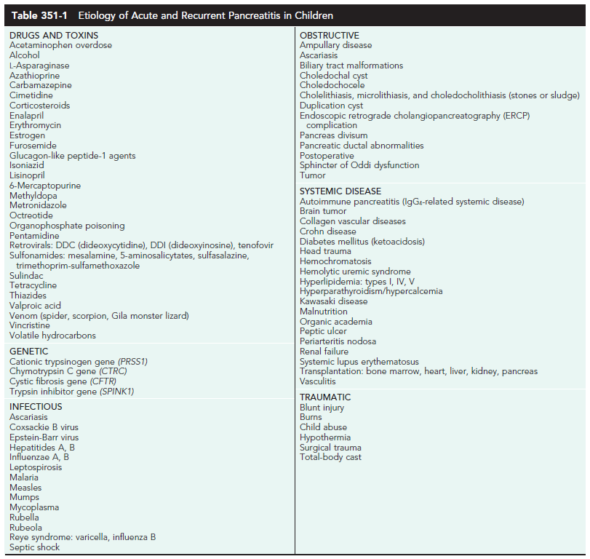
Etiologies
25% unknown
<5% idiopathic
Ref: Nelson Textbook of Pediatrics 20th

Slide 12
Histopathology
Interstitial edema
Localized and confluent necrosis
Blood vessel disruption leading to hemorrhage,
Inflammatory response in the peritoneum

Slide 13
Criteria
2 of 3 of the following:
  abdominal pain
  serum amylase +/- lipase > 3x ULN
  imaging findings
Ref: Nelson Textbook of Pediatrics 20th

Slide 14
Clinical Manifestations
Mild Acute Pancreatitis
  Severe abdominal pain(87%), persistent vomiting(64%), possibly fever.
  The pain increase in intensity for 24-48 hr
  The prognosis : excellent
Notes:
failure of pancreatic tissue to
enhance on CT scan (suggesting necrosis)

Slide 15
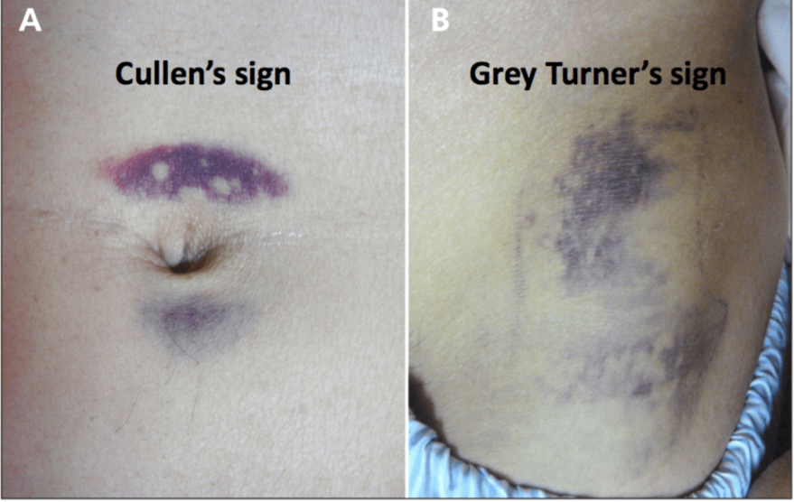
Severe Acute Pancreatitis (rare)
  Severe nausea, vomiting, abdominal pain.
  Shock, high fever, jaundice, ascites, hypocalcemia, PLE
  Cullen sign or Grey Turner sign:
    necrotic, inflammatory
  Mortality rate: ~ 20%
  The percentage of necrosis on CT scan : the severity of the disease.

Slide 16
LAB
Lipase:
  rises by 4-8 hr,
  peaks at 24-48 hr,
  remains elevated 8-14 days
Amylase : elevated for 4 days
Others: HCT↑, WBC↑, glucose↑, rGT↑, Bilirubin↑, glucosuria, coagulopathy, Ca↓

Slide 17
Abdominal X-rays
sentinel loop, dilation of the transverse colon (cutoff sign)
Ileus
pancreatic calcification (if recurrent)
blurring of the left psoas margin
a pseudocyst
Diffuse abdominal haziness (ascites)
peripancreatic extraluminal gas bubbles.

Slide 18
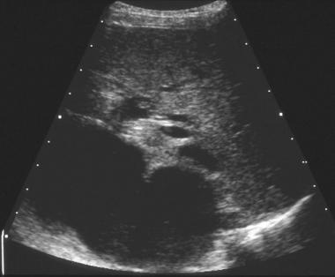
Ultrasonography
Primary screening tool
Absence of ionizing radiation
The ability to image without sedation

Slide 19
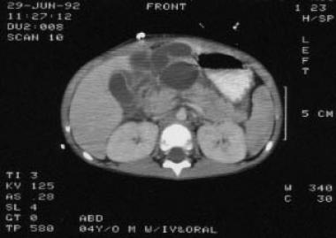
Abdominal CT
Pancreatic enlargement
Hypoechoic, sonolucent edematous pancreas
Pancreatic masses
Fluid collections
Abscesses
≧20% children initially normal

Slide 20
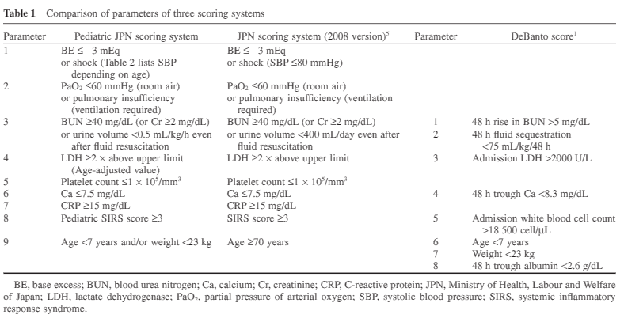
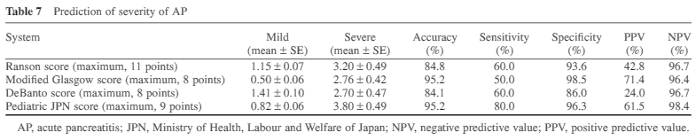
Severity

Slide 21
Treatment
Relieve pain and restore metabolic homeostasis
Fluid, electrolyte balance
If Vomiting: NG, NPO
Early refeeding(within 2-3 days of onset): the complication rate↓ and length of stay↓.
Recovery : within 4-5 days.
Antibiotics: infected necrosis, prophylactic
Acute pancreatic pseudocysts
  <5 cm: OBS 4-6 weeks.
  >5 : may require surgical intervention.

Slide 22
Conclusion
Lab: CBC/DC, GOT/GPT, rGT, amylase/lipase, BUN/Cr, CRP, LDH, electrolyte(Na,K,Cl,Ca), ABG, glucose, TG/cholesterol
Image: Abdominal X-ray, Abdominal sonography, abdominal CT
Treatment:
  Pain control(Acetaminophen, Tramadol, Demerol)
  Fluid suppulment, nutrition support
  Antibiotic if necrotic pancreatitis
  NG tube if vomiting,

Slide 23
Chronic pancreatitis
Genetic mutations
Congenital anomalies of the pancreatic or biliary ductal system.

Slide 24
Referance
Nelson Textbook of Pediatrics 20th
Medscape

